Slide 1

World Statistics Analysis
CS661 GROUP PROJECT

Slide 2
GROUP 16 MEMBERS
ANJANESH RAKESH (200133)
MANAN KABRA (200552)
MANAS KUMAR (200555)
SACHIN KUMAR (200832)
SIDDHARTH SHARMA (200981)
YASH BARJATYA (201138)
YASHWARDHAN SINGH (201157)
YOGESH NAIN (201165)
YUDHVEER SIDHU (201166)

Slide 3
Problem Statement
Develop a project for visual analysis of world statistics across population, economy, environment, and social issues.
Compare data of each country across selected features from 2000 to 2010.
Identify trends, differences, and insights to aid in understanding and addressing global problems effectively.
Analyze correlations between features and trends in changes like economic rates or average incomes of selected countries over the years.

Slide 4
Importance
Aim to present insights into global trends, disparities, and critical issues.
Enhance informed decision-making for policy, development, and resource allocation.
Emphasize the importance of hard data for understanding and addressing global challenges effectively.

Slide 5
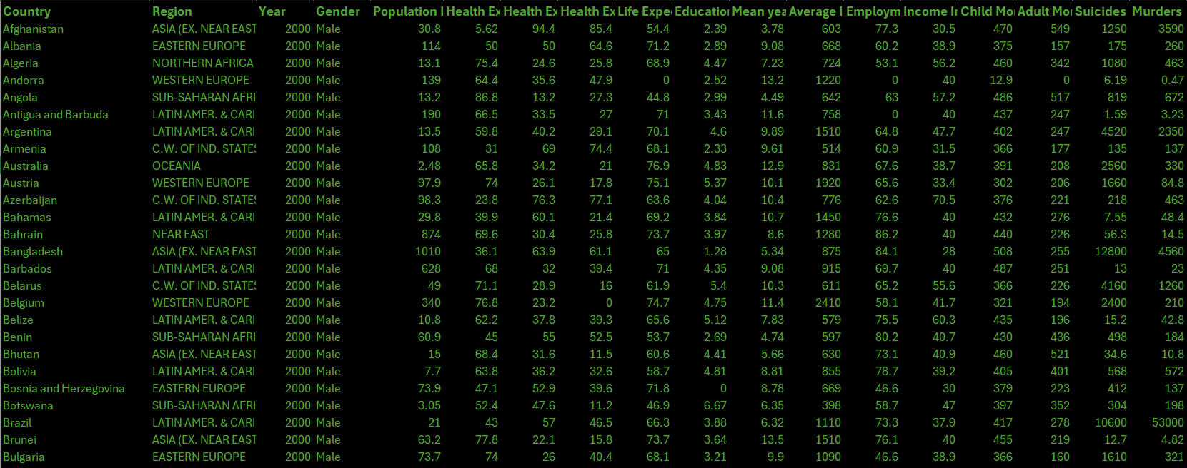
DATASET
The project dataset combines various individual datasets of different indicators sourced from multiple reliable sources, merged by country. Each feature includes attributes like Country and its yearly values for the specified indicator within a specific range.

Slide 6
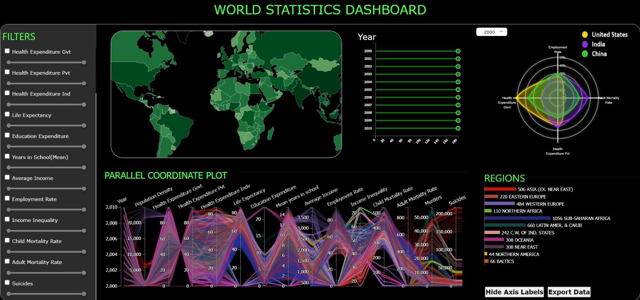
Dashboard Design
Lollipop Bar Chart
Radar Plot
Filters
Choropleth Map
Parallel Coordinates Plot
Region Bar Chart

Slide 7
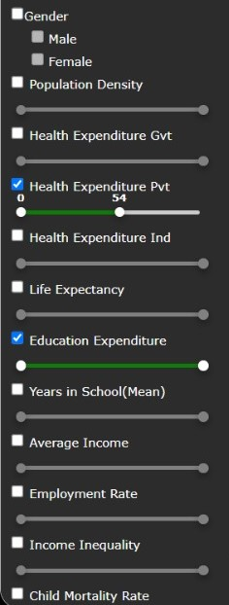
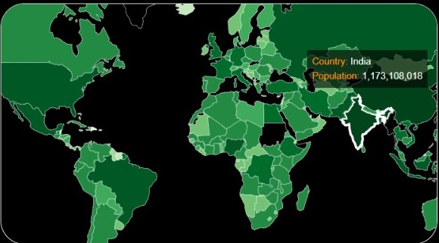
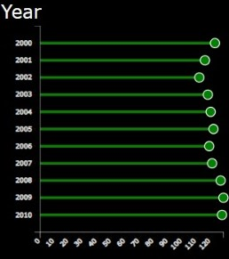
Elements of Dashboard:
Lollipop Bar Chart: It is basically a bar plot, where the bar is transformed in a line and dot. It shows the relationship between numeric and a categorical variable.
Filters: It consists of filters can be applied on the various features of the dataset in order to analyze specific category of items.
Choropleth Map: It is a thematic map that is used to represent statistical data using color mapping symbology technique.

Slide 8
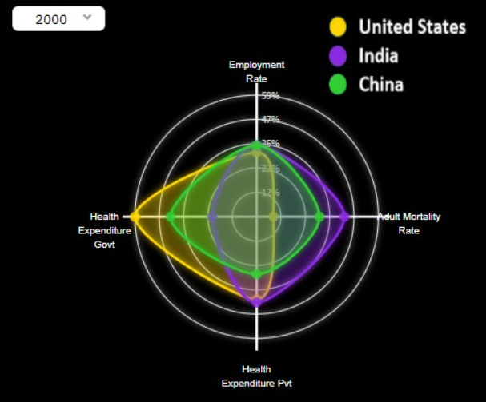
Radar Plot
A graphical data used to exhibit on a 2D chart to assess the symmetry of the values
Comparison of top feature obtained using linear dimensionality reduction technique PCA
Data Visualization of 3 countries involving
four features on different axis
‹#›
Different year filters

Slide 9
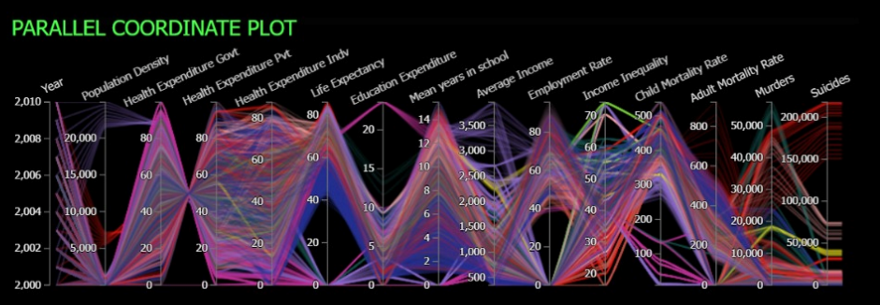
Multivariate Trends: Parallel Plot
Visual representation of multivariate data over 11 years
Each line represents a country, connecting data points for 14 factors
Axes represent years, parallel axes represent factors
‹#›

Slide 10
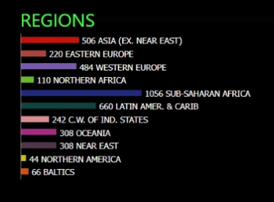

Region Filter: Customize Your View
Interactive filter allowing selection of specific regions
Enable/disable regions to focus on specific areas of interest
Effortlessly compare trends across different regions
‹#›

Slide 11
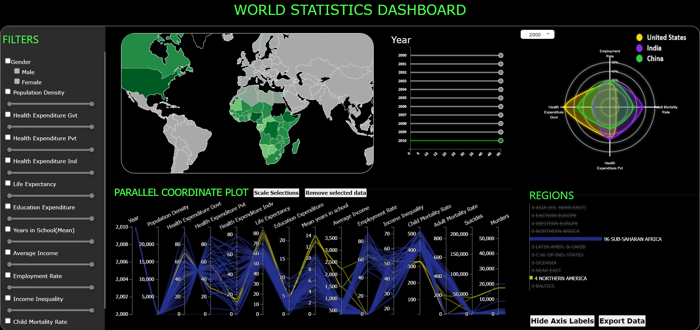
Sub-Saharan Africa vs North America
Comparative Analysis
Chosen regions shaded on map
Life Expectancy
Health Exp. by Govt.
Mean years in School
North America
Life Expectancy
Health Exp. by Govt
Mean years in Schooling
Avg. Income
Health Exp. by
Pvt.
Adult & Child Mortality Rate
Only 2010’s data selected
Only Sub- Saharan Africa & North America Selected

Slide 12
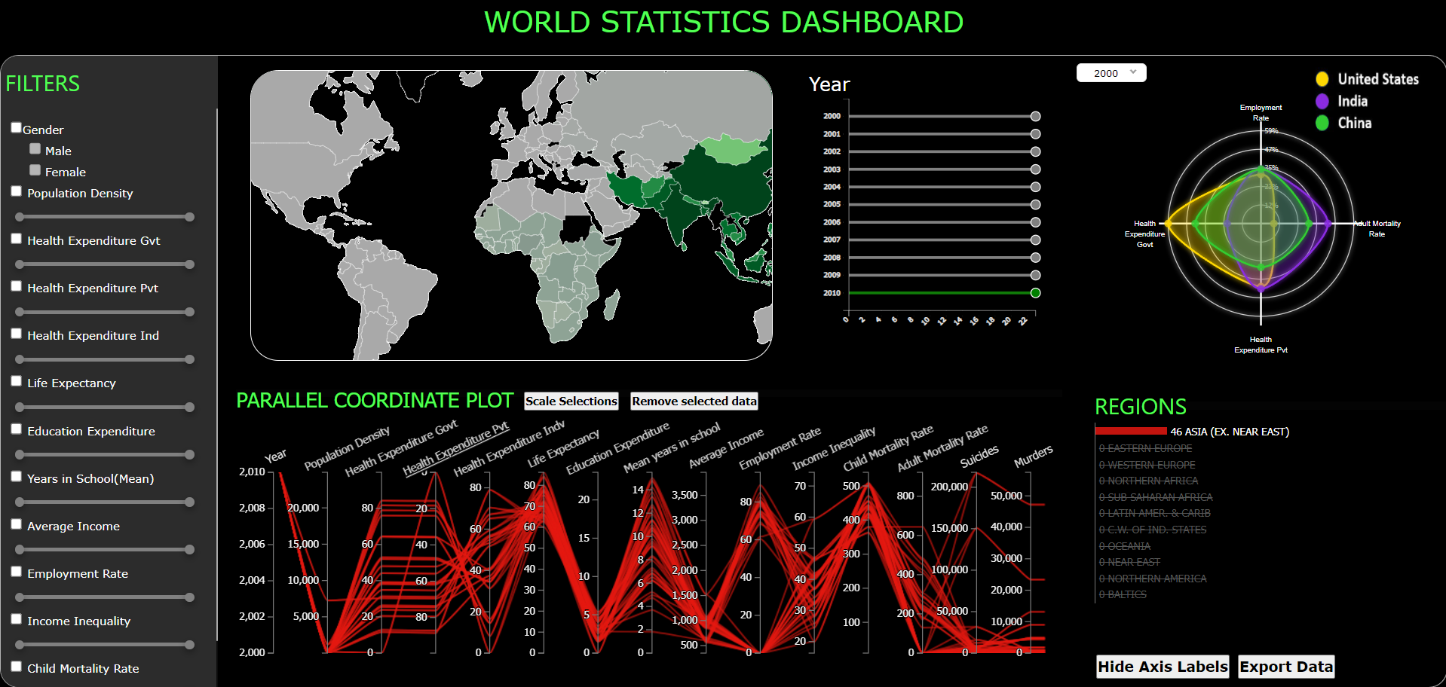
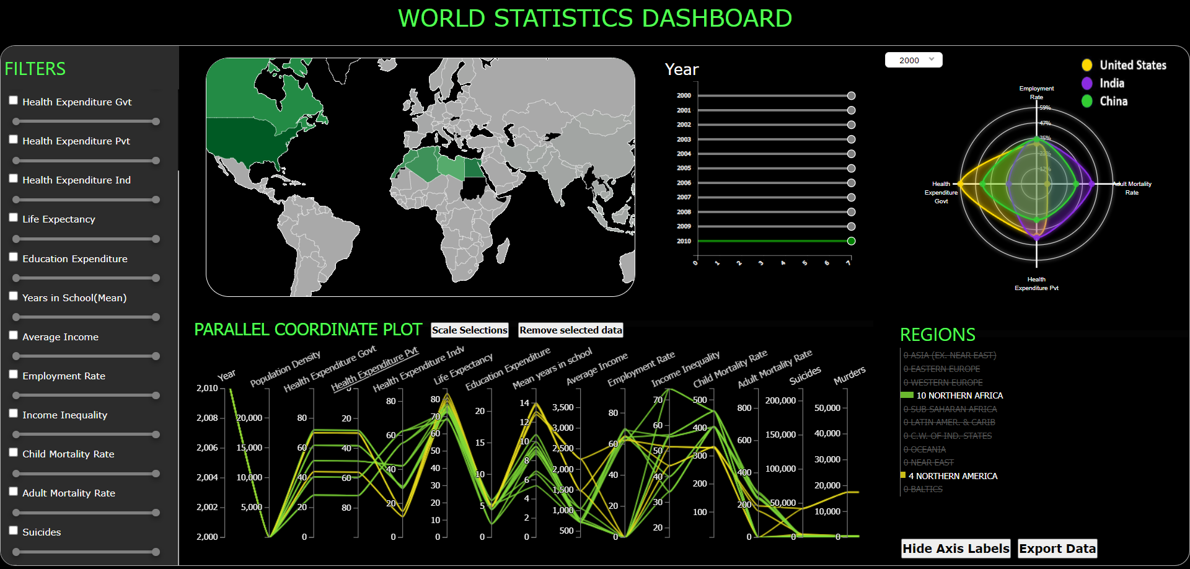
Asia - Health Expenditure Pvt vs Govt
North Africa & America-
Mean Years in Schooling vs Avg. Income
Higher the Health Expenditure
by Govt
Lower is the Health Expenditure
by Pvt
Higher years in schooling
Higher is the avg. income

Slide 13
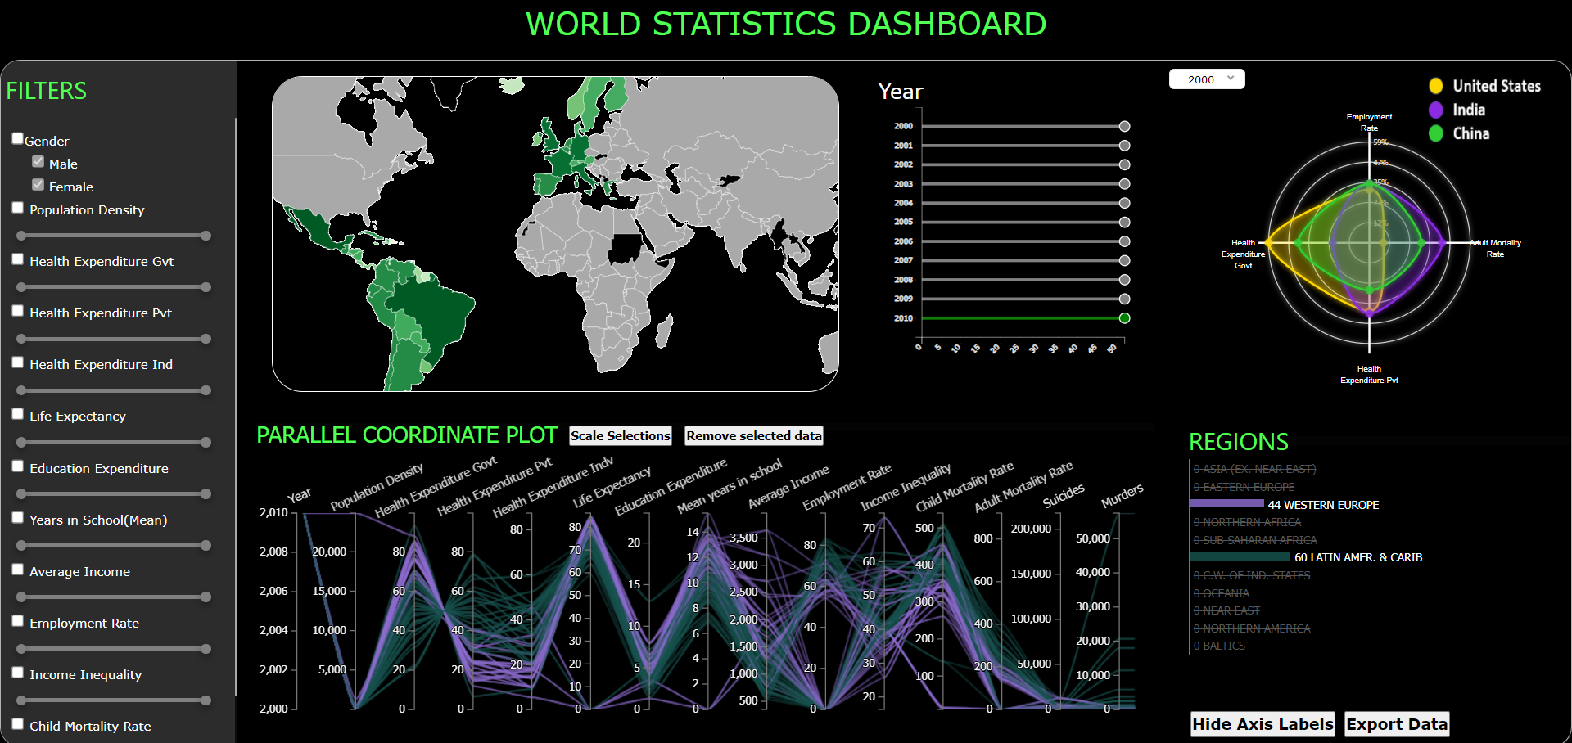
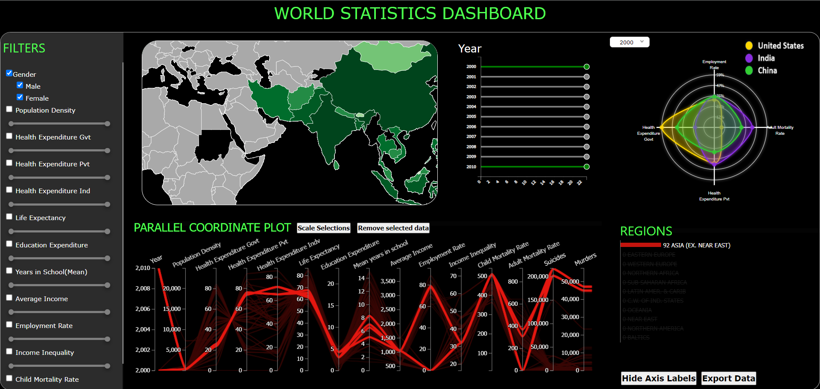
Western Europe & Latin America-
Income & Schooling vs Crime
India- Mean Years In School ( 2000-2010)
Higher Mean
Years in Schooling & higher the average income
Lesser is the crime rate
Mean Years in School Increased from 2010 to 2020

Slide 14
Challenges Faced
Difficulty in Dataset Acquisition:
Encountered issues in gathering datasets for the period of 2010-2020, potentially limiting the scope of analysis.
Handling of Empty/Null Values:
Addressing the presence of empty or null values within the dataset required careful data cleaning and imputation strategies.
Determining Optimal Data Visualization Techniques:
Selecting the most effective visualization methods to present the extensive information extracted from the dataset, ensuring concise representation in limited space.

Slide 15
Thank you
Would love to answer any queries you may have

